Slide 1

PHYSICIAN ASSISTED SUICIDE

Slide 2
Defining physician assisted suicide
It is the act of killing oneself with the help of someone who provides the knowledge or the means to do so.
Many prefer to call it physician aid in dying
This is because the word ‘suicide’ has negative connotations.
It is different from Euthanasia .

Slide 3
Difference between Physician assisted suicide and Euthanasia
In physician assisted suicide, doctors can provide patients with medications to end their lives.
But the patients have to take the medications by themselves.
In Euthanasia, the doctor or another person administers the medication.

Slide 4

Patients who qualify for physician assisted suicide
Patients have to be terminally ill.
Their doctors must believe they have six months or less to live.
Must be able to take the drugs by themselves
Must have the mental capacity to know what they are doing and the consequences.

Slide 5
Patients who qualify for physician assisted suicide Cont’d
Must make two verbal requests 15 days apart.
Must make one written request with two witnesses.
The attending physicians and consulting physician must verify the patients meets all the criteria.
Rules are there to make sure patients know what they are doing

Slide 6
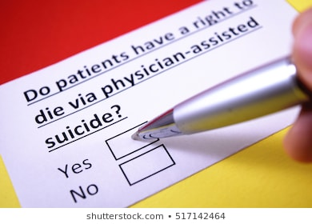
Main arguments allowing doctors to hasten patients’ death
Basic question is one of autonomous
That is my life.
Why shouldn’t I have the right to take my life if it is the appropriate thing to do?
Suicide is not illegal.
Doctors control the means, why should they withhold it from me?

Slide 7
Arguments against physician assisted suicide
The fear of being an ethical slippery slope.
Allowing physician assisted suicide to terminally ill people opens way to offering it to people who are not mentally competent,
And to people who are in distress
Religious argument about sanctity of life that death should not be hastened

Slide 8

Stance
I believe people should have control over how and when they die.
However, the patients should be in their right states of mind.
I believe the religious argument against it is the most dominant.
But I think it should only apply to believers.
The rest of the population should not be held to this standard.

Slide 9
Resolution
It is clear that one way to hasten your death is to voluntarily stop eating and drinking.
If I was suffering and dying, and it is time to hasten the process, I would stop eating and drinking.
One does not have to implicate the doctor or anyone else in their death
Unlike taking a medicine that kills you, when you stop eating and drinking, you could change your mind at some point.

Slide 10
References
Appelbaum, P. S. (2018). Physician‐assisted death in psychiatry. World Psychiatry, 17(2), 145.
Jansen, L. A., Wall, S., & Miller, F. G. (2019). Drawing the line on physician-assisted death. Journal of medical ethics, 45(3), 190-197.
Sumner, L. W. (2017). Physician-assisted death: What everyone needs to know. Oxford University Press.

